Slide 1
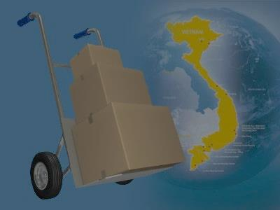
A web-based application that manages the activities of delivery service system by coach
i-DELIVER
SPRING 2014 - Group 18
1

Slide 2
Team members
Supervisor: Nguyễn Trọng Tài
Nguyễn Thanh Tùng
Lê Phúc Lữ
Nguyễn Tấn Đức
Team leader: Đào Bảo Long
2

Slide 3
Outline
Scenario problems
Propose solution
Feature and constraint of new system
Demonstration
Future plan
Technology & development environment
Algorithm description
3

Slide 4
Scenario problems
Paper documents
Ineffective manual work
Lack of statistics report
Unable to tracking, manage packages
4

Slide 5




Actors of system
Customer: person requests for package delivery from their location to another location.
Guest: same as customer but don’t log in
to system so be restricted in some function.
Staff: persons in charge of manage delivery request and manage journey.
System admin: person take
responsibilities of manage staff
and fee.
5

Slide 6


Propose scenario
[Optional] Payment online
Post request
Notify payment
information
Provide delivery
service, tracking request
Manage services,
users
Manage journey
information, request
Provide mechanism to manage
Provide mechanism to manage
6

Slide 7







Technology & development environment
15

Slide 8



Problem description
1
Cà Mau – Cần Thơ, V=100dm³
X
Đã xếp lịch
2
Cà Mau – Đà Lạt, V=200dm³
X
Y
Đã xếp lịch
3
Cần Thơ – Đà Lạt, V=300dm³
Y
Đã xếp lịch
4h
3h
8h
Đà Lạt
Cần Thơ
Cà Mau
Sài Gòn
X
Y
12:00 PM, 3/6,
V = 2500 dm³
7:00 AM, 3/6,
V = 4700 dm³
12:00 PM, 3/6,
V = 2800 dm³
7:00 AM, 3/6,
V = 5000 dm³
12:00 PM, 3/6,
V = 3000 dm³
7

Slide 9
Normal case
1
Đã đến đích
Cà Mau – Cần Thơ, V=100dm³
X
Đã chuyển đi
Đã chuyển đi
2
Cà Mau – Đà Lạt, V=200dm³
X
Y
Đã đến đích
Cần Thơ – Đà Lạt, V=300dm³
Đã đến đích
3
Y
Đã chuyển đi
4h
3h
8h
Đà Lạt
Cần Thơ
Cà Mau
Sài Gòn
X
Y
11:55 AM, 3/6,
V = 2500 dm³
7:00 AM, 3/6,
V = 4700 dm³
12:00 PM, 3/6,
V = 2500 dm³
7:05 AM, 3/6,
V = 4700 dm³
11:50 AM, 3/6,
V = 5000 dm³
11:20 AM, 3/6,
V = 4700 dm³
7

Slide 10
Abnormal case
1
Đã đến đích
Cà Mau – Cần Thơ, V=100dm³
X
Đã chuyển đi
2
Cà Mau – Đà Lạt, V=200dm³
X
Y
Đã chuyển đi
Z
Cần Thơ – Đà Lạt, V=300dm³
Y
Đã chuyển đi
3
Đã đến đích
4h
3h
8h
Đà Lạt
Cần Thơ
Cà Mau
Sài Gòn
X
Z
Y
13:00 PM, 3/6,
V = 3000 dm³
11:55 AM, 3/6,
V = 2500 dm³
7:00 AM, 3/6,
V = 4700 dm³
12:00 PM, 3/6,
V = 2500 dm³
7:05 AM, 3/6,
V = 4700 dm³
12:00 PM, 3/6,
V = 4700 dm³
7

Slide 11

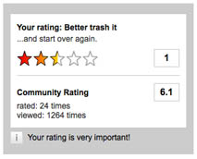

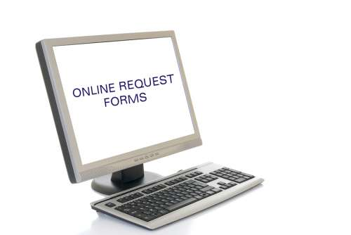

Feature of new system
Request for packages delivery easily
Simple way to tracking packages
Online payment
Easy to manage packages
Rating and comment
Statistics on revenue
16

Slide 12


Constraints of new system
Each station must have staff with basic computer skills to mange request & journey
Each station must have computer connects to Internet
17

Slide 13
DEMONSTRATION
18

Slide 14



Future plan
Develop mobile applications for manage packages pick-up/delivery process at customer’s house
Develop and optimize algorithms for coach scheduling and reduce cost of delivery process
19

Slide 15
Thanks for your listening! Q&A
20

